Slide 1
Tableau AND SQL PROJECT : Bike-Share Dashboard
By Amirul Afiq Rosli

Slide 2
Introduction
The Process flows
I have successfully completed a project that involved utilizing SQL for dataset cleaning and transforming the cleaned data into a TXT file. Subsequently, I imported the cleaned data into Tableau to create a business intelligence dashboard for visualization purposes.
Identify Objectives
Find Dataset
Cleaning Dataset
Upload the Cleaned Dataset into Tableau
Upload Into Github
Making Interactive Dashboard

Slide 3
Identify Objectives
Objectives :
Conducting analysis to identify the month with the highest number of rides
Analyzing customer preferences to determine the most preferred rideable type
Examining ride length data by weekday and rideable type to identify the most common ride durations.
What to do?
1. Performed data cleaning using SQL, ensuring data integrity and removing inconsistencies or errors.
2. Created a comprehensive Bike-Share Dashboard using Tableau, visualizing key metrics and insights
related to bike sharing data.

Slide 4
Find Dataset
Sources: 2021-divvy-tripdata.zip lists
Dataset name : Dataset Link : https://divvy-tripdata.s3.amazonaws.com/index.html

Slide 5
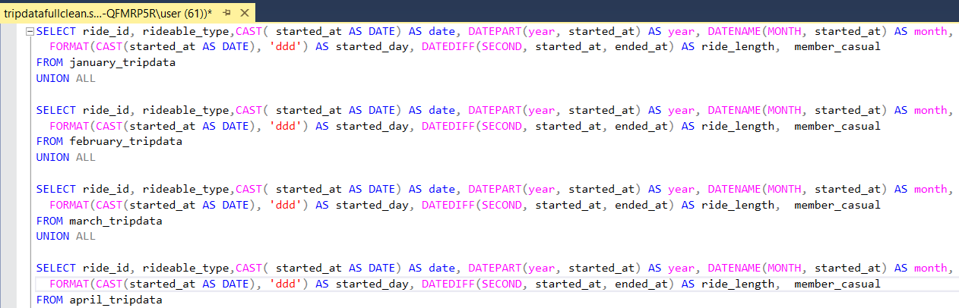
Cleaning Dataset
Tools :
SQL Server Management Studio Management Studio 19
Process:
Conducted data cleaning by utilizing the "UNION ALL" clause in SQL to combine and merge data from January 2021 to December 2021.
Employed data extraction techniques to transform the dataset into meaningful information.
The queries done :

Slide 6
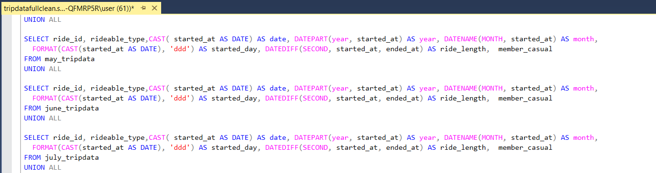

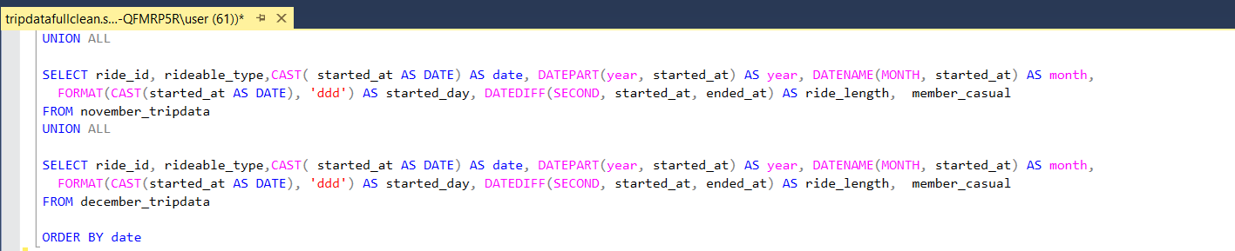

Slide 7
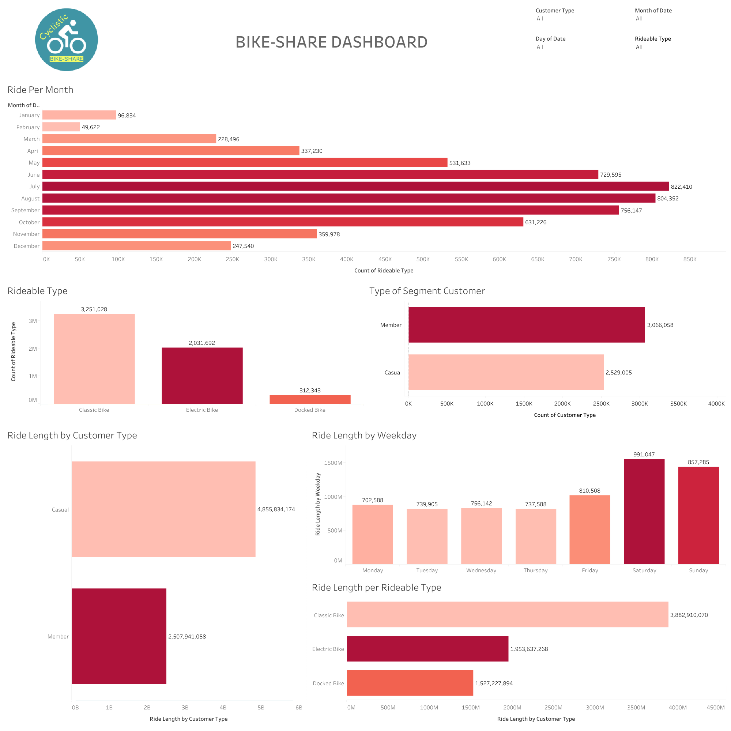
Making Interactive Dashboard

Slide 8
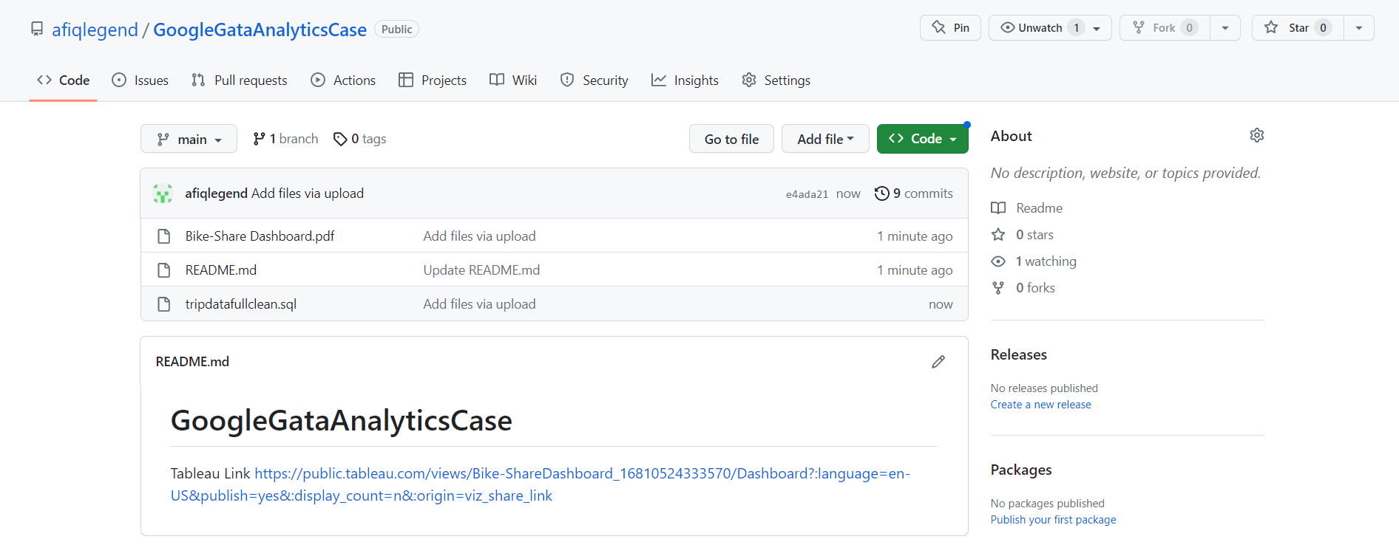
Upload Into Github
Upload all my project files into Github for completing the portfolio.
Link : https://github.com/afiqlegend/GoogleGataAnalyticsCase

Slide 9
Conclusions
The results:
The month with the highest number of rides was July, with a total of 822,410 rides.
The preferred rideable type among customers was the Classic Bike, with 3,251,028 rides.
Found that Saturday had the highest ride length, totaling 991,047 seconds and the Classic Bike type had the longest ride length, with a duration of 3,882,910,070 seconds.
Skills Acquired:
1. Proficiency in crafting SQL queries in SSMS to cleanse datasets and extract relevant information
for visualization purposes.
2. Expertise in creating interactive dashboards using Tableau, enabling the concise presentation
of complex data through visual reports.
3. Familiarity with fundamental concepts of business logic, facilitating a deeper understanding of
how organizations operate and make informed decisions.

